Slide 1
Levels and packet switching problems

Slide 2
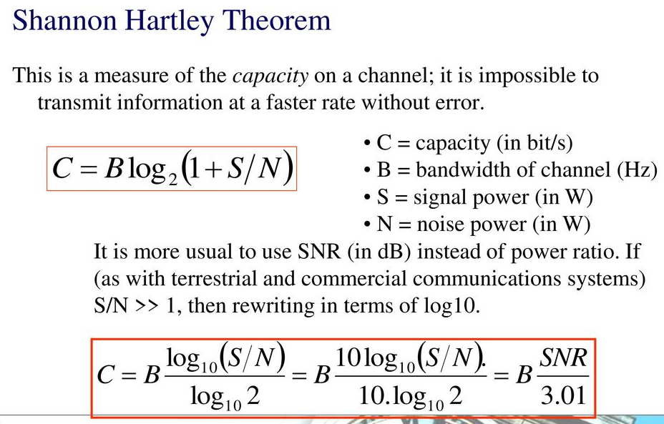

Slide 3
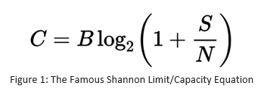

Slide 4
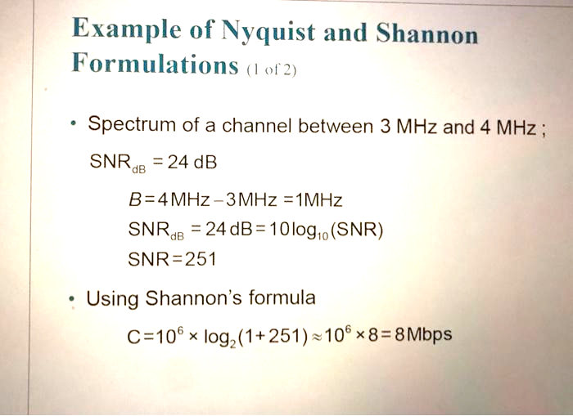

Slide 5
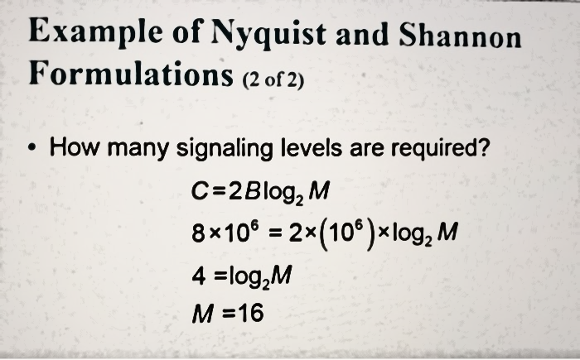

Slide 6
13.A telephone line normally has a bandwidth of 3000. The signal-to-noise ratio is usually 3162. For this channel the capacity is calculated as
This means that the highest bit rate for a telephone line is 34.860 kbps. If we want to send data faster than this, we can either increase the bandwidth of the line or improve the signal-to-noise ratio.

Slide 7
14.We have a channel with a 1-MHz bandwidth. The SNR for this channel is 63. What are the appropriate bit rate and signal level?
Solution
First, we use the Shannon formula to find the upper limit.
The Shannon formula gives us 6 Mbps, the upper limit. For better performance we choose something lower, 4 Mbps, for example. Then we use the Nyquist formula to find the number of signal levels.

Slide 8
Propagation and Transmission Delay
Propagation Delay = Distance/Propagation speed
Transmission Delay = Message size/bandwidth bps
Latency = Propagation delay + Transmission delay + Queueing time + Processing time

Slide 9
Example
What is the propagation time if the distance between the two points is 12,000 km? Assume the propagation speed to be 2.4 × 10⁸ m/s in cable.
Solution
We can calculate the propagation time as
The example shows that a bit can go over the Atlantic Ocean in only 50 ms if there is a direct cable between the source and the destination.

Slide 10
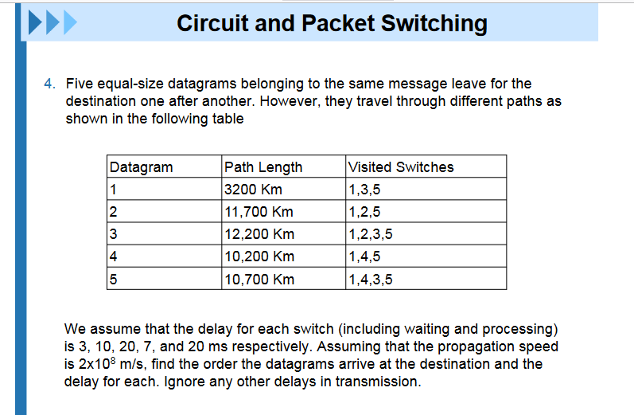

Slide 11
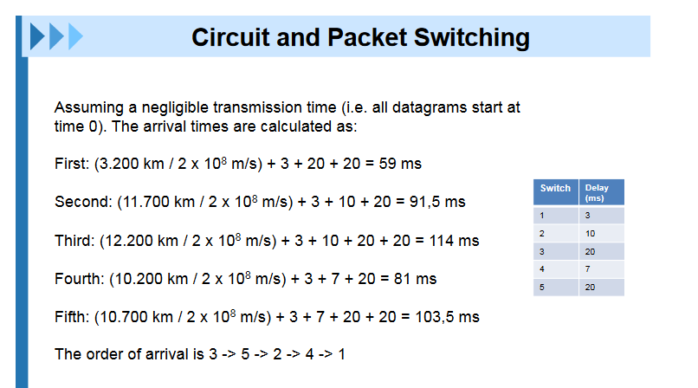

Slide 13
Figure shows a switch (router) in a datagram network. Find the output port for packets with the following destination addresses: Packet 1: 7176 Packet 2: 1233 Packet 3: 8766 Packet 4: 9144

Slide 14
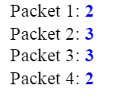
Figure shows a switch (router) in a datagram network. Find the output port for packets with the following destination addresses: Packet 1: 7176 Packet 2: 1233 Packet 3: 8766 Packet 4: 9144

Slide 15
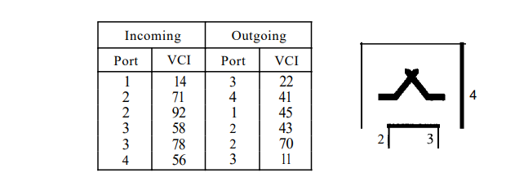
Find the output port and the output VCI for packets with the following input port and input VCI addresses: Packet 1: 3, 78 Packet 2: 2, 92 Packet 3: 4, 56 Packet 4: 2, 71

